Slide 1

Data Lead Project
Automatic Fraud Detection
Ophélie
Céline
Samba

Slide 2



Objective : fraud detection
In 2019, European Central Bank estimated fraudulent credit car transactions up to 1 Billion Euros !
Goal : use AI can help detect fraudulent payments
Real time payment ingestion
Efficient fraudulent payment detector

Slide 3
Proposed solution
1. Develop ML algorithm to detect frauds
2. Have real-time payment transactions recorded and predicted
3. Classify each payment and send prediction to notification center
4. Verification by user if prediction is valid
5. Input new labelled data into ML-algorithm training

Slide 4
1. Training Dataset EDA
Approximately 0.39 % fraud (553574 true transactions and 492 frauds)

Slide 5
1. Training Dataset EDA
Approximately 0.39 % fraud (553574 true transactions and 492 frauds)
While normal transactions tend to be around $200 or less, we see fraudulent transactions peak around $300 and then at the $800-$1000 range

Slide 6
1. Training Dataset EDA
Approximately 0.39 % fraud (553574 true transactions and 492 frauds)
Some spending categories see more fraud than others!
Fraud tends to happen more often in 'Shopping_net', 'Grocery_pos', and 'misc_net'
While normal transactions tend to be around $200 or less, we see fraudulent transactions peak around $300 and then at the $800-$1000 range

Slide 7
2. Data stack
1st ETL : once

Slide 8
2. Data stack
1st ETL : once
Model Conception
+
Model stored in S3

Slide 9
2. Data stack
1st ETL : once
Model Conception
+
Model stored in S3
Real-time Data
Producer / Consumer
Prepocessing
Prediction
+

Slide 10
2. Data stack
1st ETL : once
Model Conception
+
Model stored in S3
Real-time Data
2nd ETL : every hour
Producer / Consumer
Prepocessing
Prediction
+

Slide 11
2. Data stack
1st ETL : once
Model Conception
+
3rd ETL : data drift analysis
=> Model update
Model stored in S3
Real-time Data
2nd ETL : every hour
Producer / Consumer
Prepocessing
Prediction
+

Slide 12
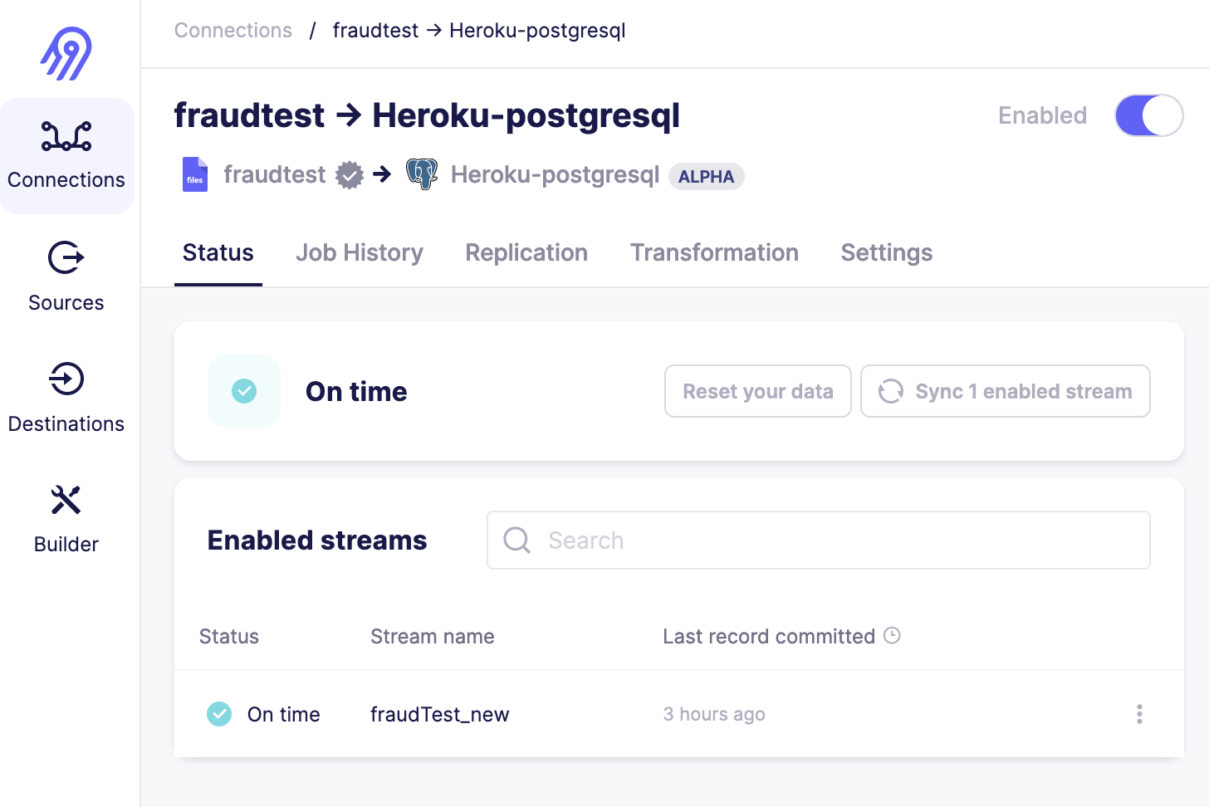
Demo – 1st ETL

Slide 13
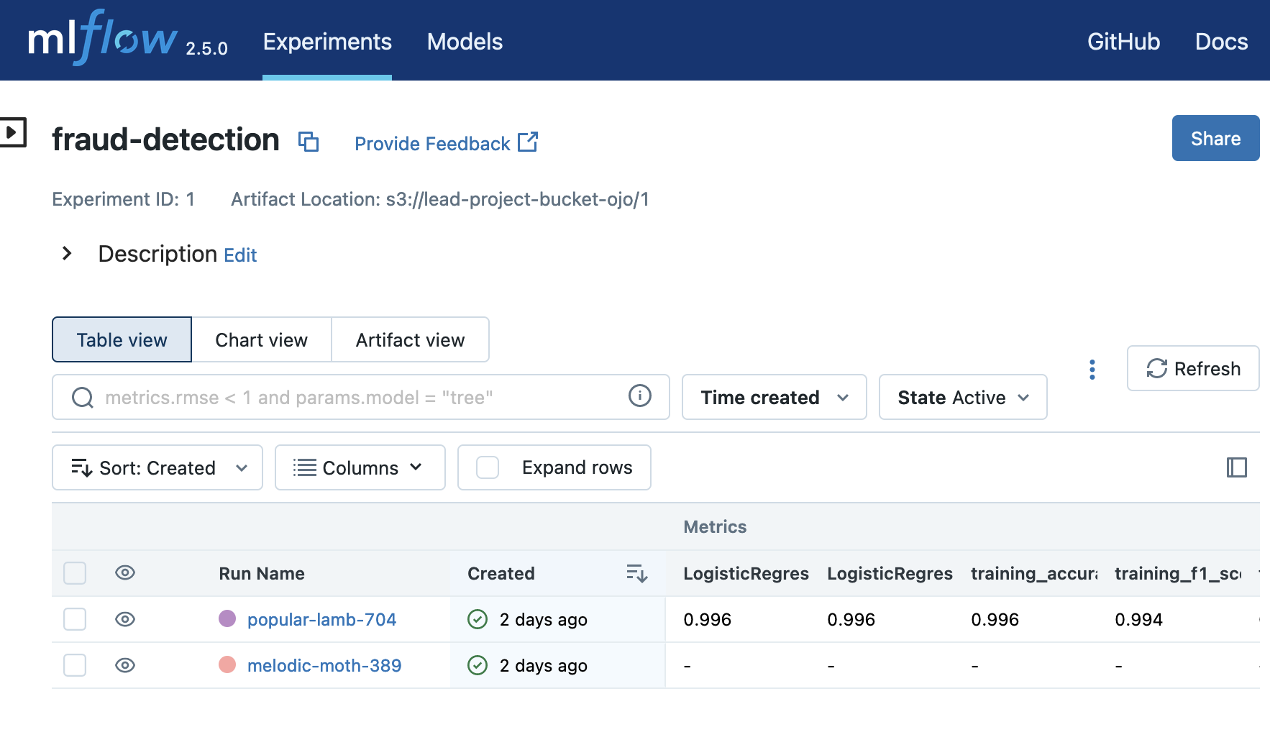
Demo – ML Conception via MLFlow
+
Model stored in S3

Slide 14
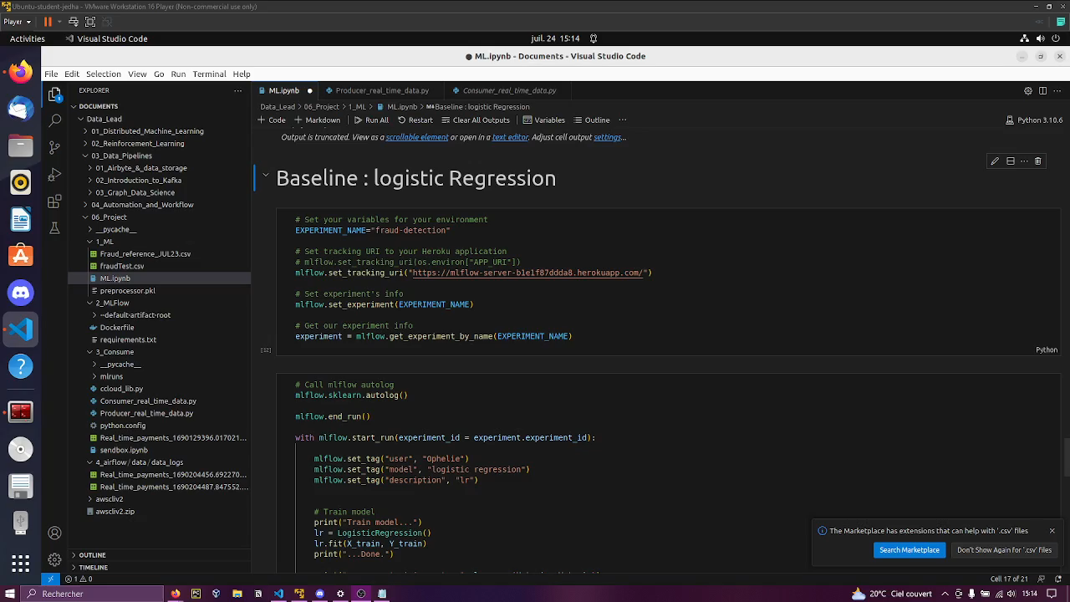
Demo – ML Conception via MLFlow

Slide 15
Demo – 2nd ETL

Slide 16
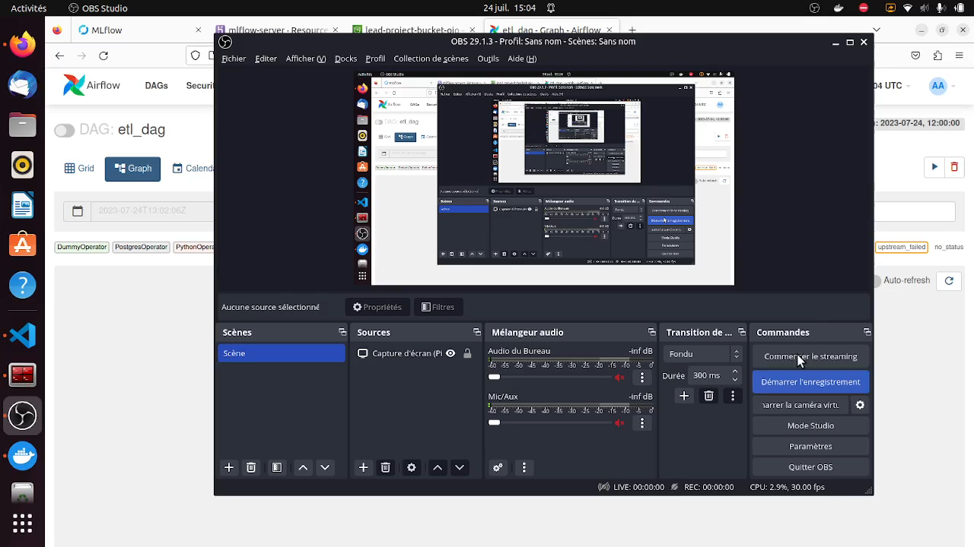
Demo – 2nd ETL

Slide 17
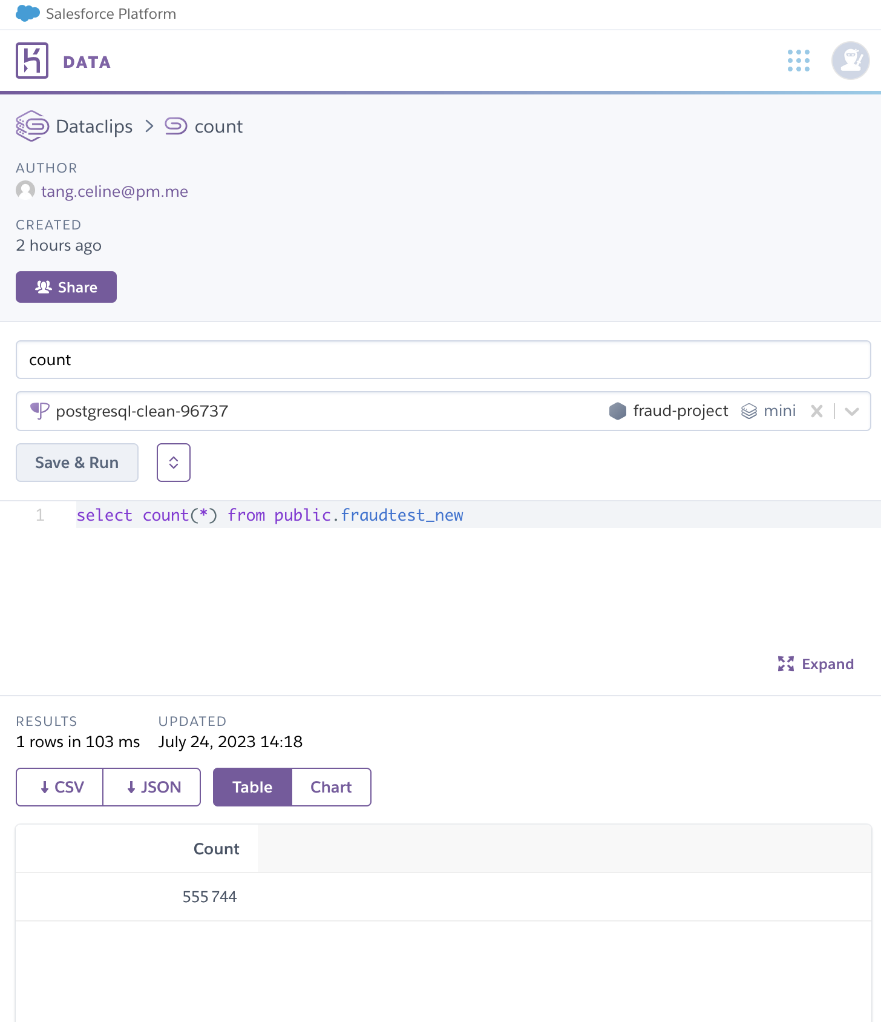
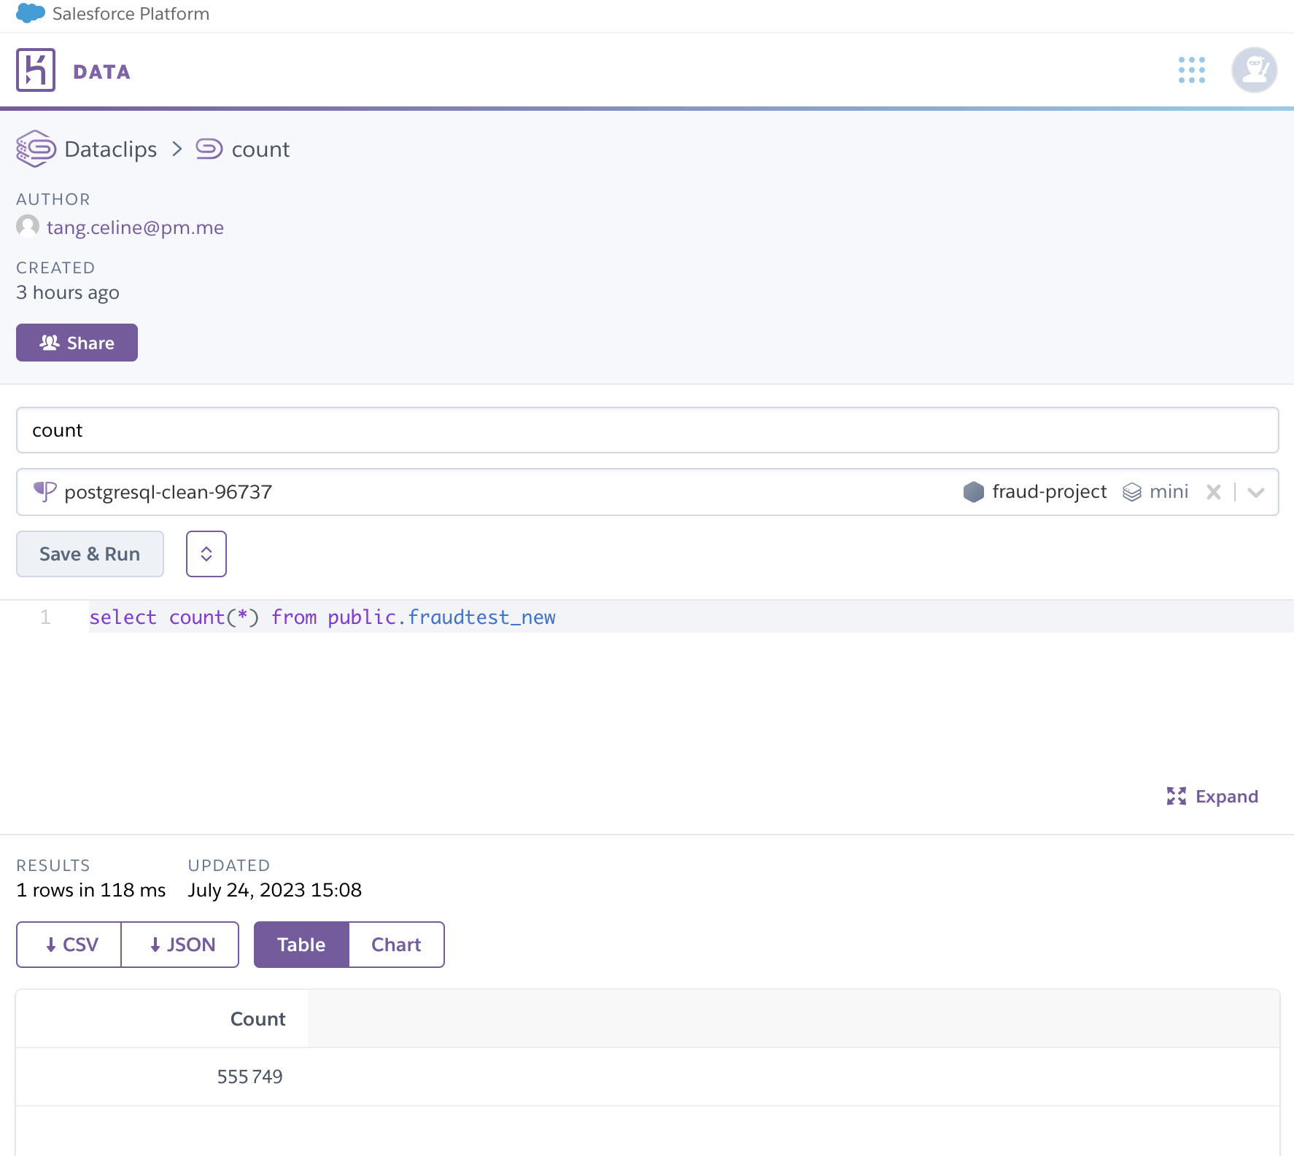
Demo – BDD before / after

Slide 18
What’s next?
Improvement of ML algorithm model : imbalanced dataset (SMOTE strategy)
Monitor Data Drift with evidently library
3rd ETL to implement : ongoing database update with correctly labelled data
Alerts and notification on real time frauds
Data accessibility for internal bank analysis

Slide 19

Any questions ?

